Slide 1

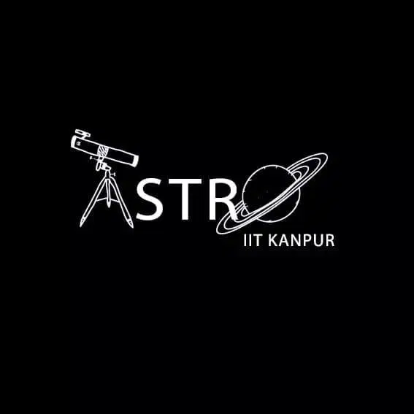
SPACE:
THE FINAL FRONTIER
Mentors:
Sunny K. Bhagat
Mubashshir Uddin
Varun Singh
Notes:
Welcome all! Mentees of the project

Slide 2
ABOUT THE PROJECT
This project lets us dive deep into the realms of Astrodynamics from analysing historical and futuristic space missions to Designing our very own missions on a simulation software.
Notes:
The major aims in the project were in depth analysis and knowledge of Astrodynamics and rocket science, appreciating the success and ideation of previous and upcoming space missions, and trying to simulate our own space missions as well

Slide 3
PROGRESS REPORT
01
02
03
04
08
07
06
05
WEEK
WEEK
WEEK
WEEK
Design
Structure
History of rockets
Rocket Equation
Re-Entry
Heat Shields
Assignment 1
Kerbal Space Program
SSTO and DSTO
Assignment 2A
Propellants
Engines
Assignment 2B
OVERVIEW
You could give a brief description of the topic here
WEEK
WEEK
WEEK
WEEK
Habitability
Interstellar Voyage
Sample Mission Reports
Orbital Dynamics
Unusual Methods of Propulsion
Communication
Trajectory Optimization
MOGA Modelling
Assignment 3
Aerodynamics
Assignment 2C
Notes:
So this is how we proceeded during the project. We learnt several diverse concepts during the timeline of the project and applied the things learnt in the assignments provided to us. We also had a lot of fun experimenting missions in Kerbal Space Program and analyzing real world space missions towards the end of the project

Slide 4
What We Covered
1. We kicked off with History of Rockets.
8. Discussing future prospects of the project, like Habitability and Interstellar Voyage and improve upon our knowledge
2. Extensive discussion on design and structure of a rocket.
FEEDBACK
LOOP :-)
7. Orbital Dynamics and Communications were covered
3. We were introduced to the ‘ROCKET EQUATION’ to understand about rocket dynamics and maneuvering.
6. Introduction to Rocket Engines and Propulsion (Even unusual methods)
4. Simulate mission launches in Kerbal Space Program
5. Introduction to Aerodynamics and Re-entry
Notes:
So we started off with a basic introduction of rockets and their history,then we discussed about the design and structure of rockets.Moving ahead we did a detailed derivation of the rocket equation trying to understand its dynamics.Then for some practical experience we simulated a fun mission on KSP, from which we explored some orbital dynamics. then we moved on to the aerodynamics and re entry of the rocket. And how can we miss the core of the rocket,its engine, so we studied that next. Orbital dynamics and trajectory optimization using moga modelling was the next important thing to be discussed. And we ended the project with some sci-fi concepts like habitability, interstellar travel and unconventional methods of propulsion.

Slide 5
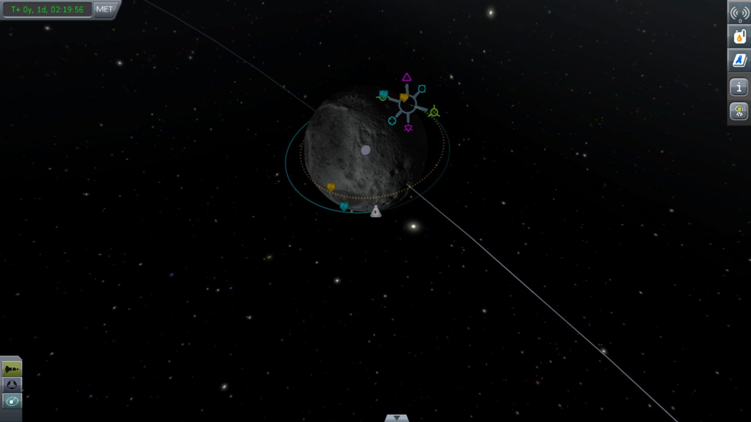
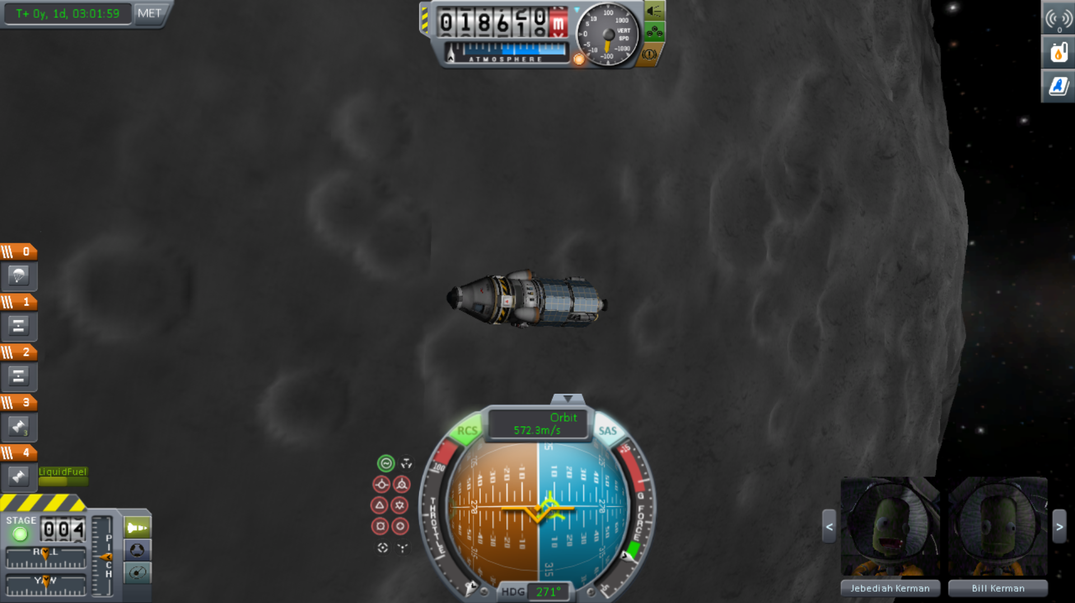

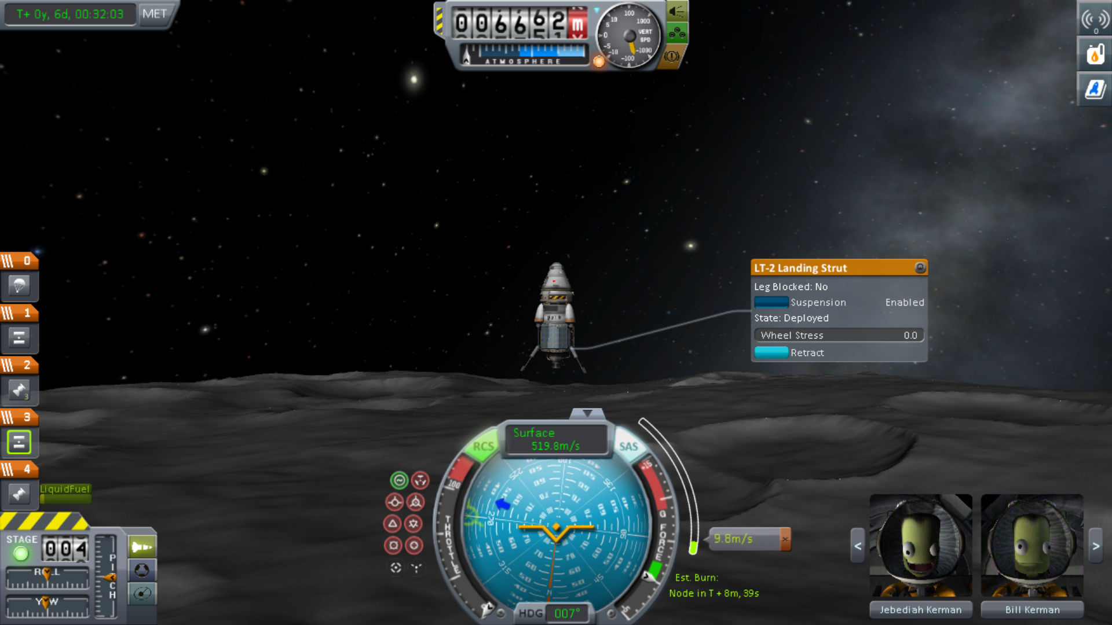
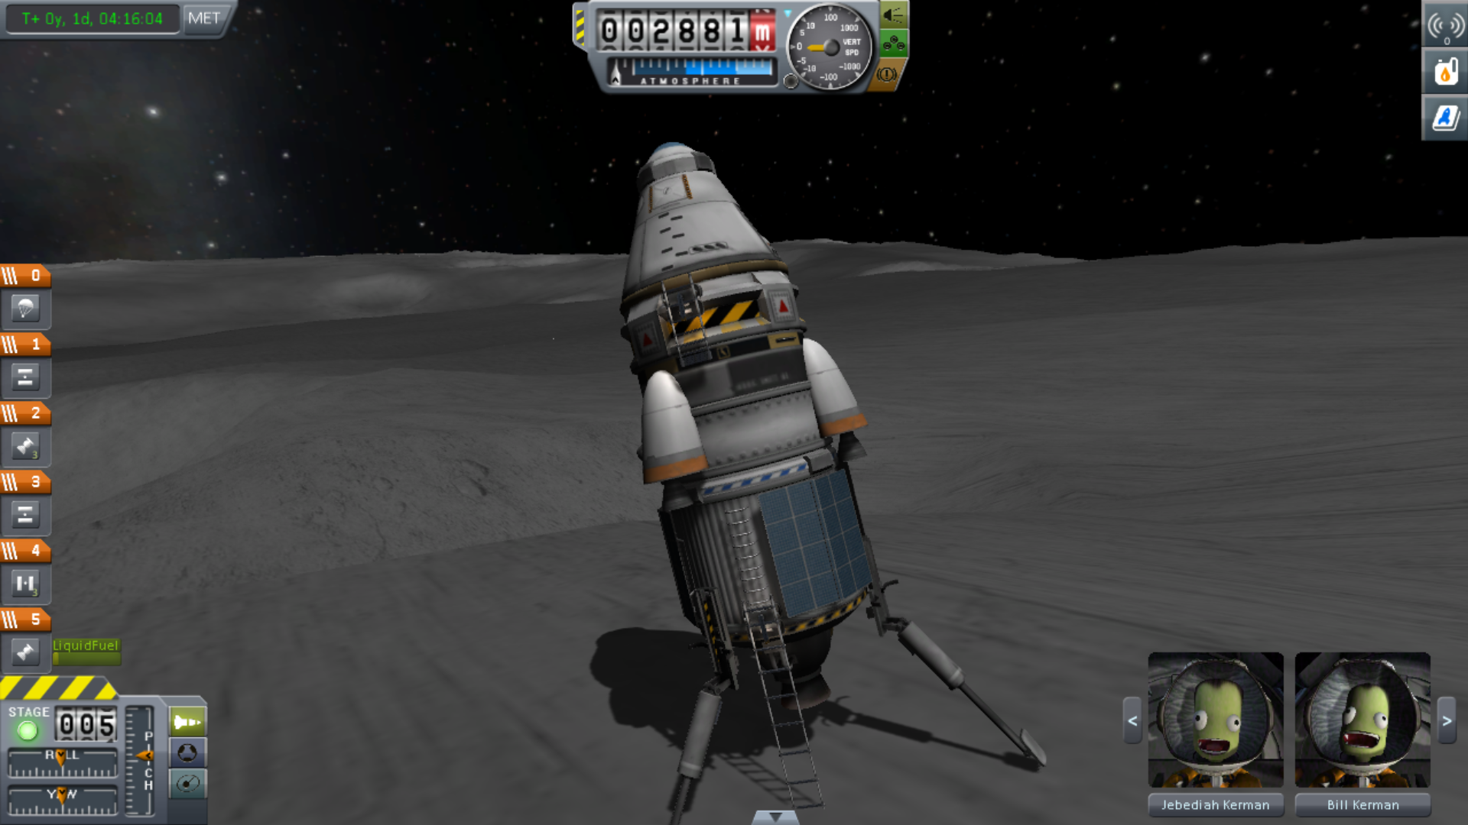
Kerbal space program
Of course theoretical knowledge is good, but what’s the fun without implementing it?
Kerbal Space Program is a Game-cum-Simulation software that allows us to get a deep insight into working of a spacecraft. If you haven’t already used it, we seriously do recommend it. Here are a few screenshots of our mission to Mun (Kerbin equivalent of Earth’s moon)
Notes:
Learning concepts is always nice, but experimenting and applying those things add much more to the fun and experience of the project. Hence, we used several things learnt like specific impulse, engine specifications etc to plan Mun and Duna missions in kerbal space program. Here are some images

Slide 6



MOGA MODELLING
As rockets are costly, we gotta optimize ‘em to yield the best results. To do this, we employ the use of MOGA (Multi Objective Genetic Algorithm).
We do so to get the ‘best of the best’, or so to speak :-)
Cost
Payload

Slide 7

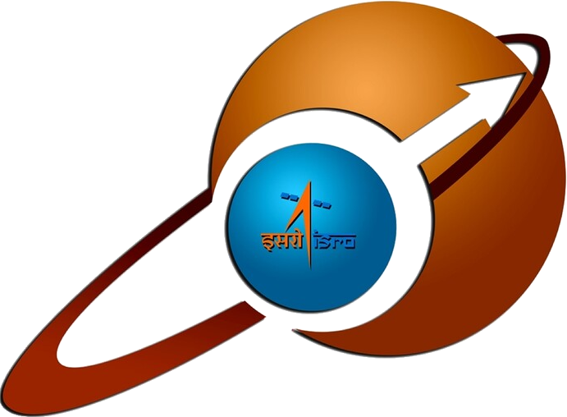

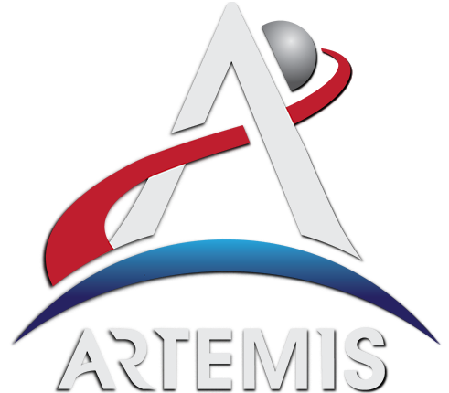
SAMPLE MISSION REPORTS
APOLLO 11
mom
It was the spaceflight launched by NASA that first landed humans on moon
Mars Orbiter Mission is ISRO’s first interplanetary mission to planet mars
CREW DRAGON RESILIENCE
ARTEMIS
This is SPACEX’s mission that launched astronauts to the ISS from United States.
It is a United States-led program with primary goal of returning humans to moon
Notes:
Thus, after learning such a diverse set of concepts, the project aimed at analyzing real world space missions in-depth, in which we covered historically important as well as futuristic missions, from the legendary Apollo 11 mission, India’s pride Mars orbiter mission, SpaceX’s crew dragon resilience mission and the promising artemis program

Slide 8
RESOURCES
WEEKLY ASSIGNMENTS
DOUBT DISCUSSIONS
REGULAR LECTURES
Regular lectures by our mentors aided by presentation
We were provided with weekly assignment for application part
Doubt sessions were conducted so as to clear all our queries related to everything taught in sessions

Slide 9
FUTURE goals
FUTURE MODELLING
APPLICATION
Trying out new modelling techniques other than MOGA such as HCD to get more accurate results.
In depth application of concepts and
Orbital Perturbations to be studied
Notes:
Even though the project has come to an end, but the learning doesnt end here. We will be further exploring new modeling techniques other than MOGA to get more accurate results.also we plan on doing indenpth analysis and application of the concepts studied.

Slide 10
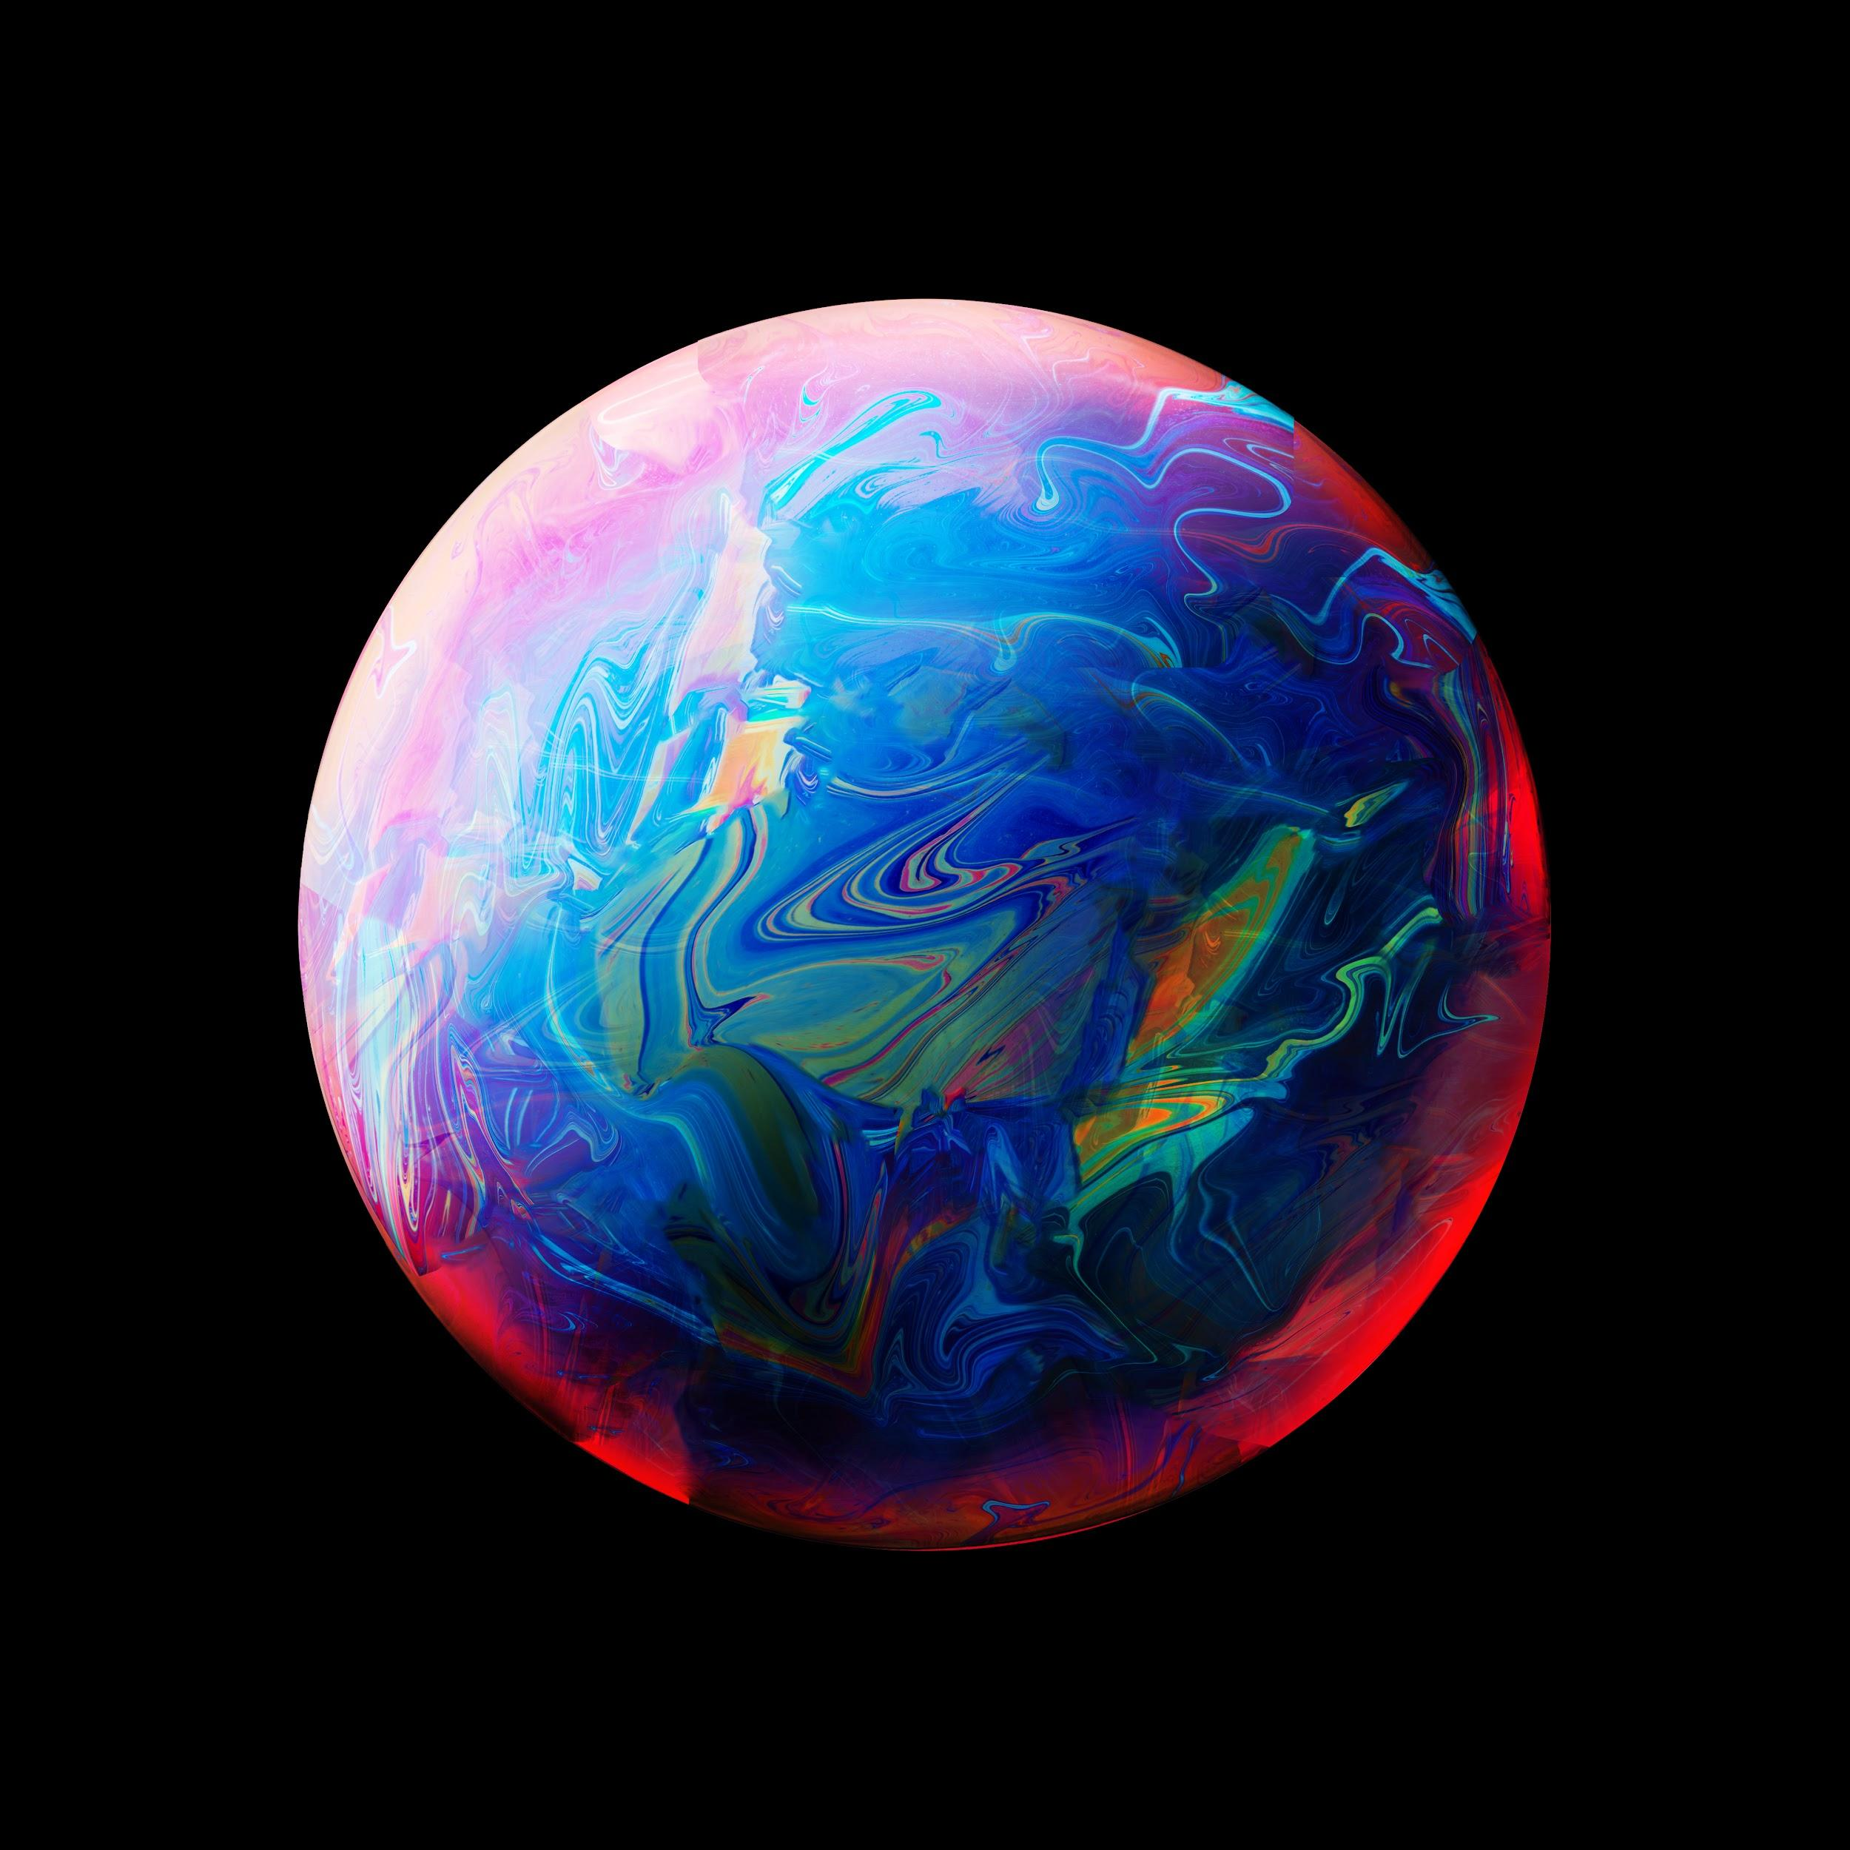
THANK YOU!
Cosmos is within us...
Space is for everybody. It’s not just for a few people in science and math or a selected group of astronauts. That’s our frontier out there and it’s everybody’s business to know about space.
- Christa McAuliffe

